Slide 1
Time Series Sentiment Analysis with LLMs
Yusuf Taha Körkem
Mevlana Halit Kaya

Slide 2
Related Studies
Georgoula et al.'s study
Ali Asgarov's research

Slide 3
Georgoula et al.'s study
Machine learning technique to assess the attitude of common Twitter users toward Bitcoin
A favorable short-term correlation between Twitter mood and Bitcoin values, indicating the potential value of sentiment analysis in price prediction
Negative relationship between the USD/EUR exchange rate and the price of Bitcoin

Slide 4
Ali Asgarov's research
Creation of a stock price prediction model through the amalgamation of historical data and emotion ratings obtained from Twitter
BERT model for sentiment scoring and a Long Short-Term Memory (LSTM) neural network for multivariate time series forecasting

Slide 5
OpenAI’s GPT 3.5 Turbo
An advanced language model developed by OpenAI
Pre-trained on a range of linguistic inputs
Adaptation to specific tasks like question answering or sentiment analysis
Performance is evaluated on a validation set using this iterative process until the intended results are achieved

Slide 6
Dataset
What? Netflix reviews on the Google Play Store
Why? Because includes timestamp values and has a suitable structure for multi-aspect sentiment analysis
Essentially consists of 1.5 million reviews from 2011 to 2023
We took the last 250,000 review, 2 exact years from 2021 to 2023

Slide 9
Our work

Slide 10
Some issues we faced
Review sentiment analysis one by one (not bulk)
Responses cut off when exceeded token limit
There is not enough positive comments about categories
LLM wrongly evaluates insignificant reviews, uses ‘Content’ as a fallback
Using fine-tuned model takes a lot of time until…
Time OK, but money?

Slide 11
Preprocessing
Reducing tokens
Removing all emojis
Replacement repetitive characters because of the OpenAI API prohibition
Finally, eliminate reviews which is entirely blank

Slide 12
Dissatisfaction Categories
Content: Complaints regarding available content, visibility, selection, deletion, removal, difficulty in finding, recommendation, leakage of new content, location-based content issues, subtitles, localization, quality adjustment, or poor video or audio quality may fall under this category.
UI/UX: Customization, navigation, user interface, user experience, and app usage difficulties are some of the topics that may be covered in this section.
Bugs/stability: Bug reports, screen brightness complaints (high or low), black screen issues, and other technical issues may fall under this category.
Customer service: Complaints pertaining to a range of customer service-related issues may fall under this category.
Subscription/payment: This topic may include complaints about pricing policies, rising subscription fees, overpriced services, invoicing problems, payment problems, cancellation of subscriptions, or problems with a monthly subscription cost.
Downloading/connection: This topic may include complaints about proxy errors, login issues, connectivity issues, casting issues, auto-download capabilities, and downloading issues.

Slide 13
Future Prediction
LSTM

Slide 14
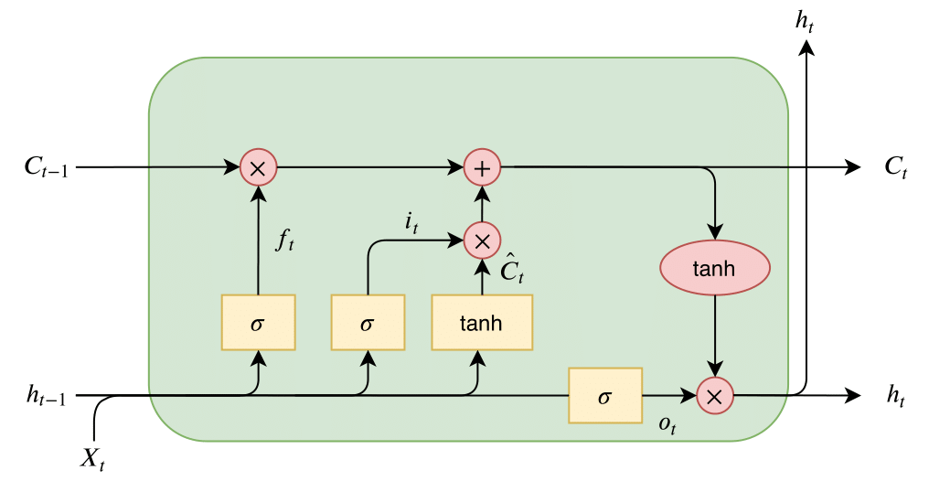
LSTM Architecture

Slide 15
LLM Training Format
Prompt
Input
Response

Slide 16
Prompt
You're an AI assistant capable of performing multi-aspect sentiment analysis on user review data. Analyze the emotion and sentiment behind each review, and find dissatisfaction categories it based on only the followings: Content, UI/UX, Bugs/stability, Customer service, Subscription/payment, Downloading/connection. If a review falls under multiple categories, return as an alphabetically sorted array containing all of those categories. If a review does not fall under any of these categories, return an empty array. Hence, each dissatisfaction array has zero or more categories. You are given an reviews object which the key is id and the value is review. Each review should be analyzed independently of the other. You must return output for every inputs given to you.

Slide 17
Input
{708:\"I'm a customer since 2016. All of a sudden, while watching a show, I got logged out and my profile disappeared. After contacting the customer service I've been told that they can't help me because tha main account holder has to contact them (my flatmate and I share one account). It's his email address but my bank account is being charged every month. I wasn't gonna bother him while he is on holidays - they said that there's nothing they can do. Unbelievable. I cancelled the subscription.\"}

Slide 18
Response
{708:[\"Bugs/stability\",\"Customer service\",\"Subscription/payment\"]}

Slide 19
Fine Tuning
…

Slide 20
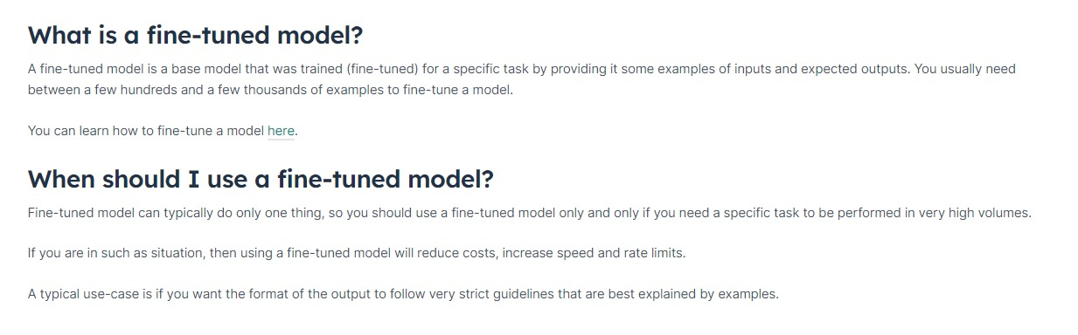
What? Why?

Slide 21
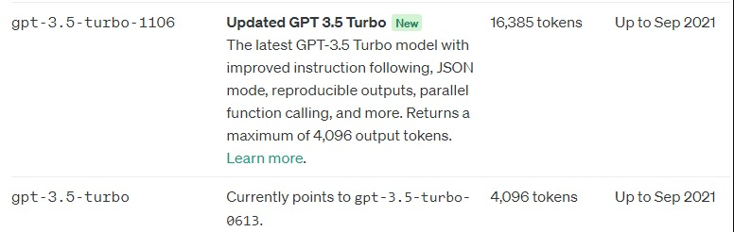
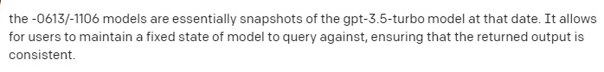
GPT-3.5 Turbo 0613 vs GPT-3.5 Turbo 1106

Slide 22
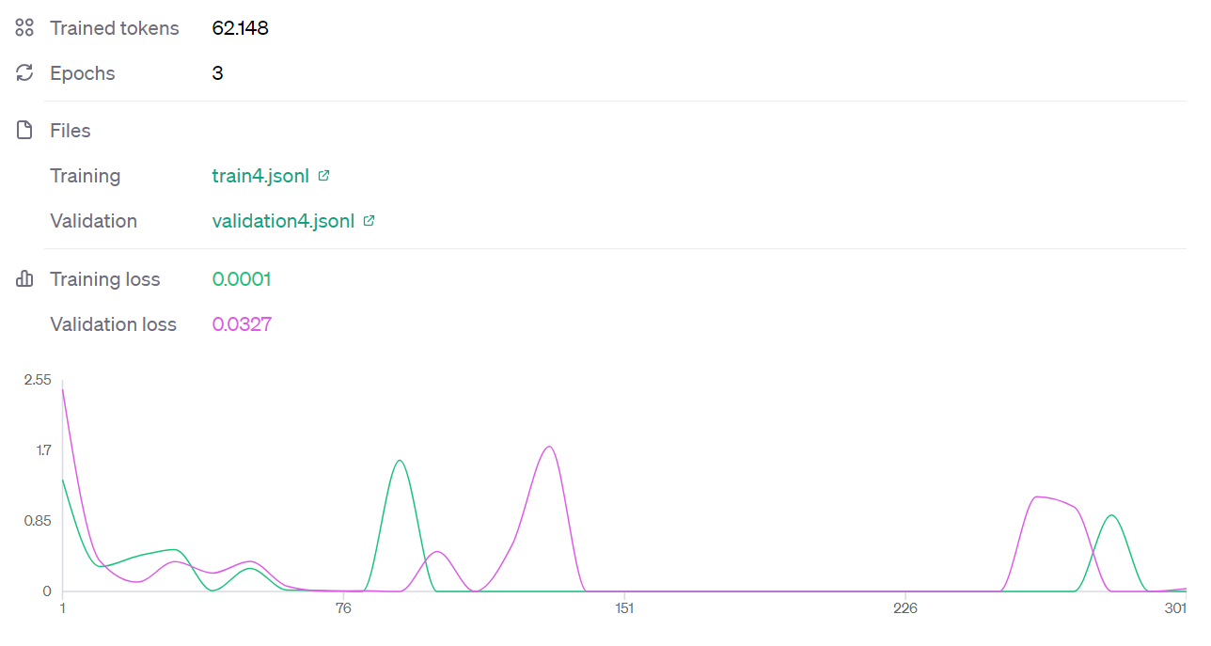
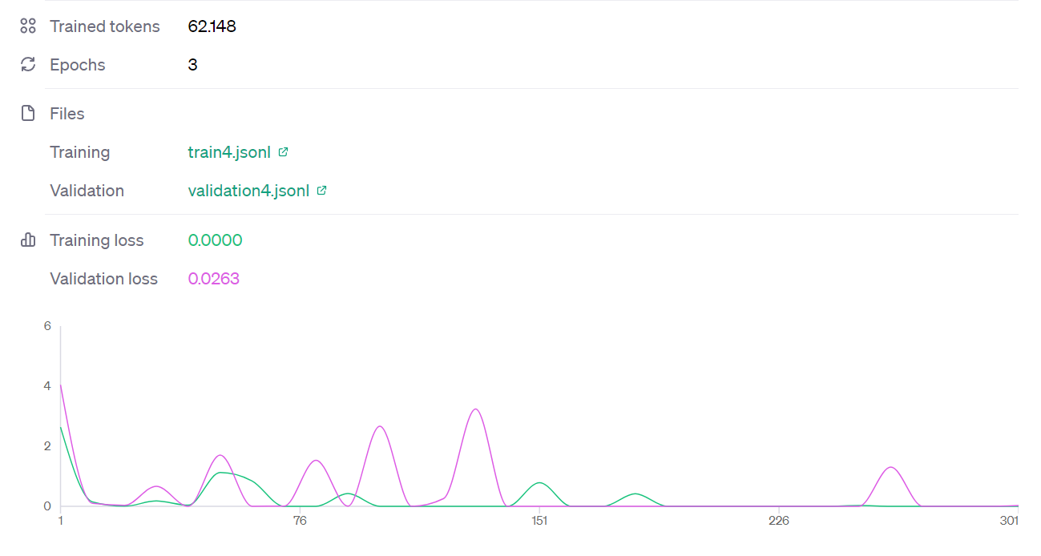
GPT-3.5 Turbo 0613 Learning Curve
GPT-3.5 Turbo 1106 Learning Curve

Slide 23
Sentiment Analysis Results
…

Slide 24
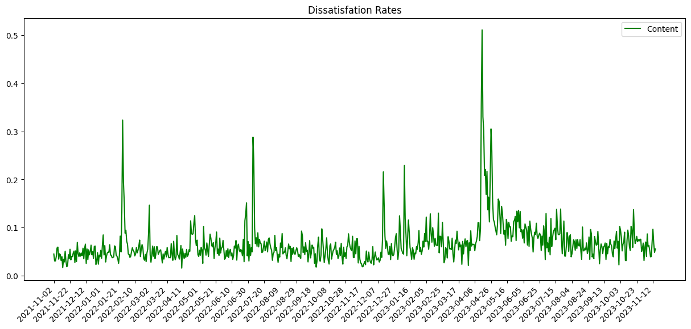
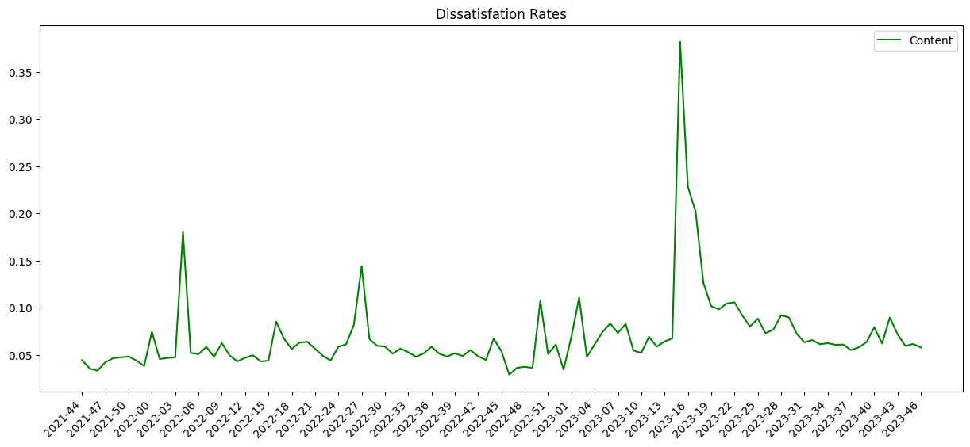
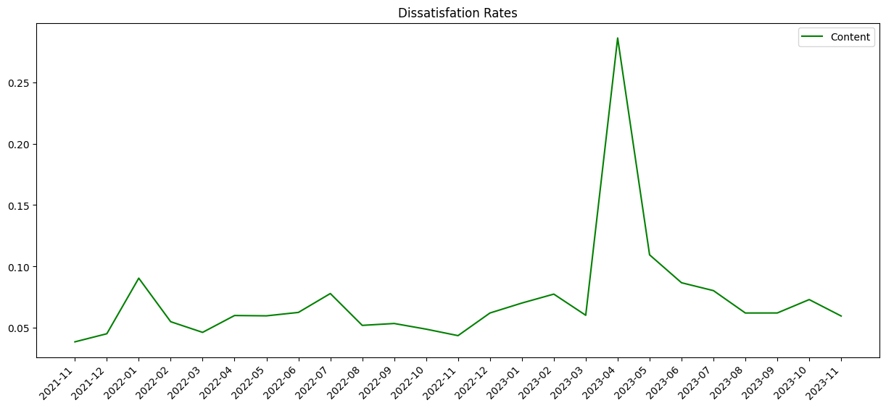

Slide 25
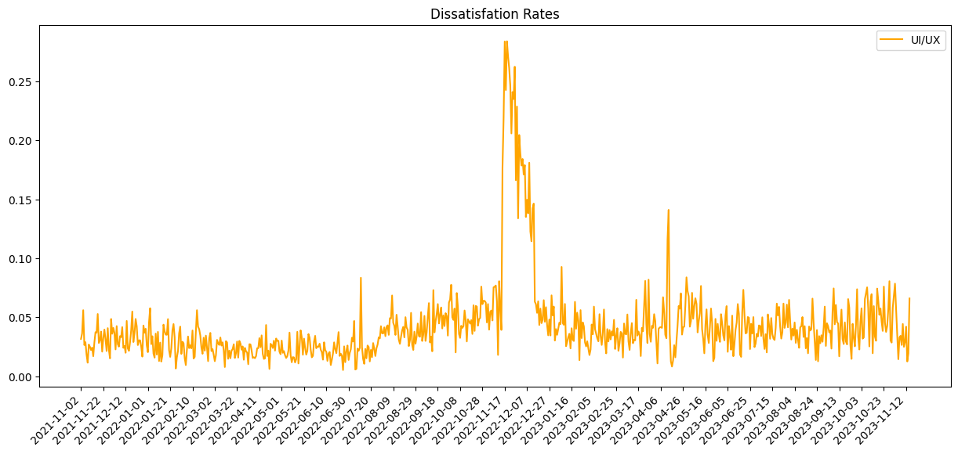
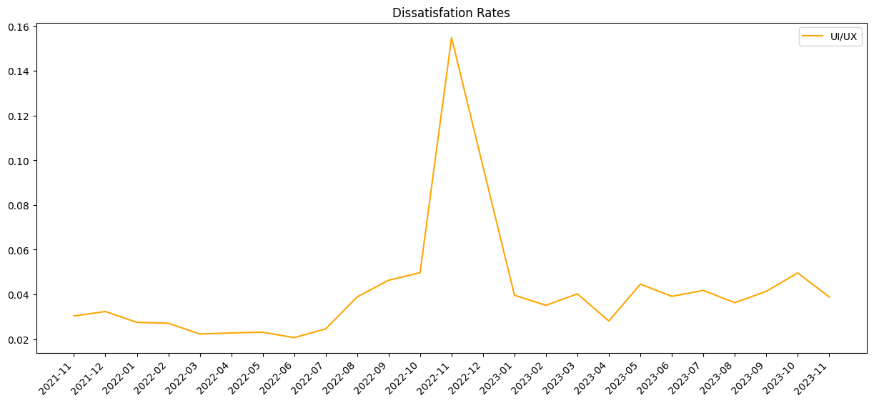
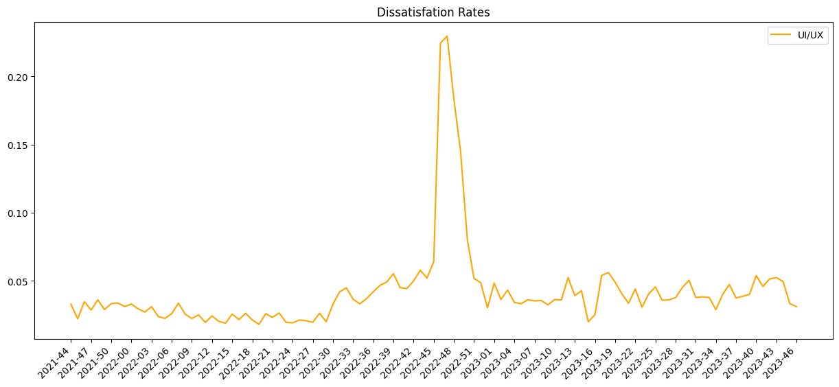

Slide 26
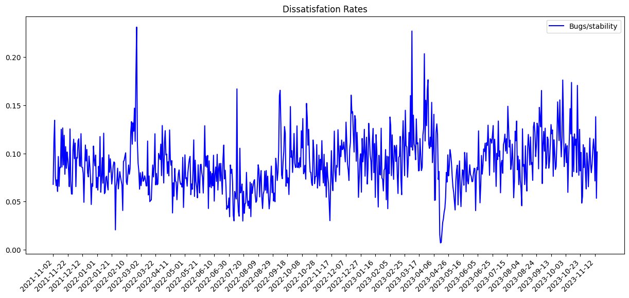
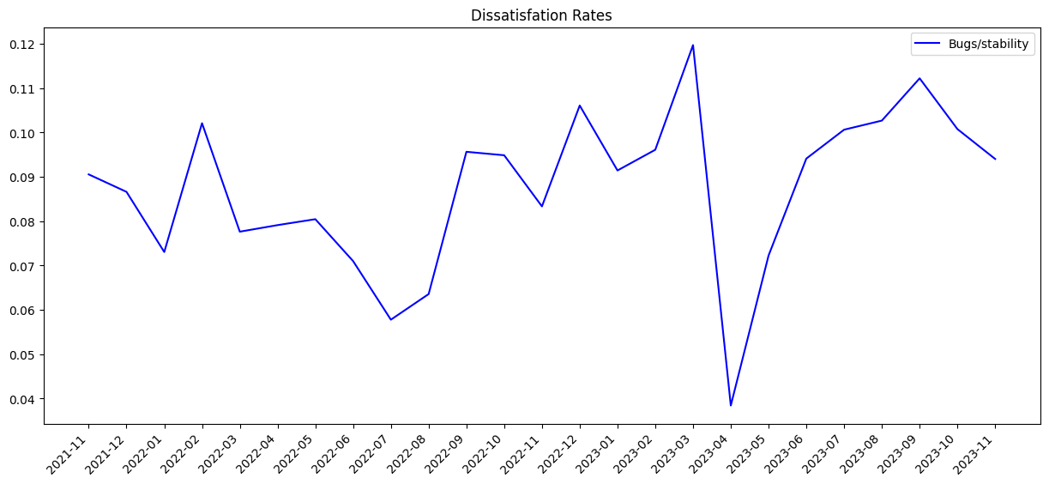
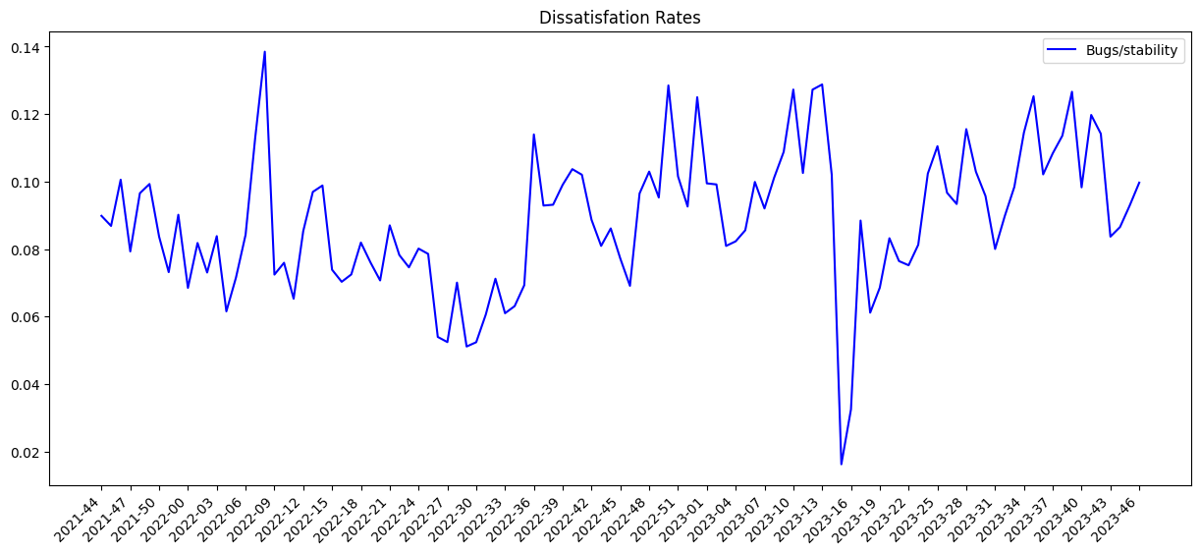

Slide 27
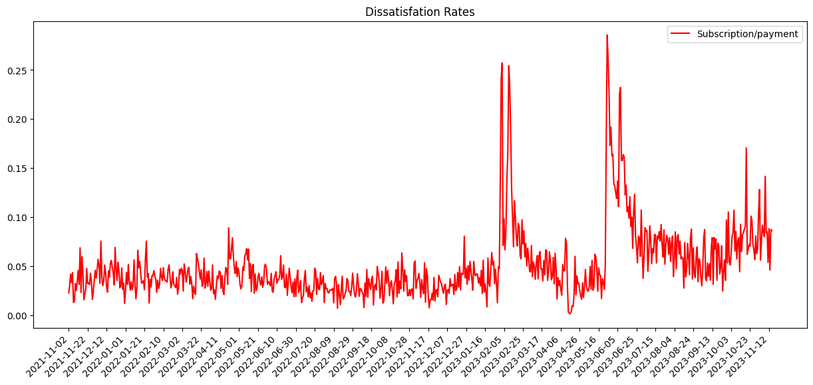
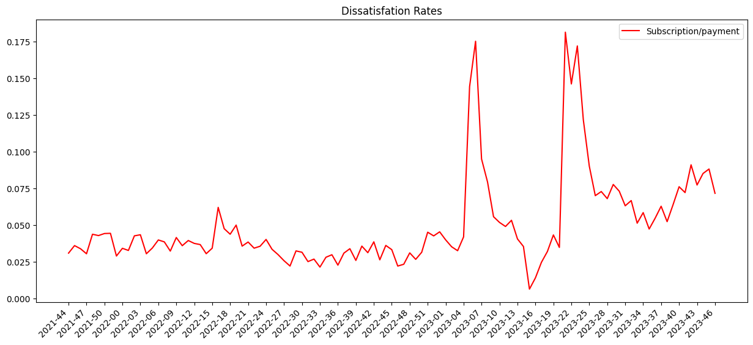
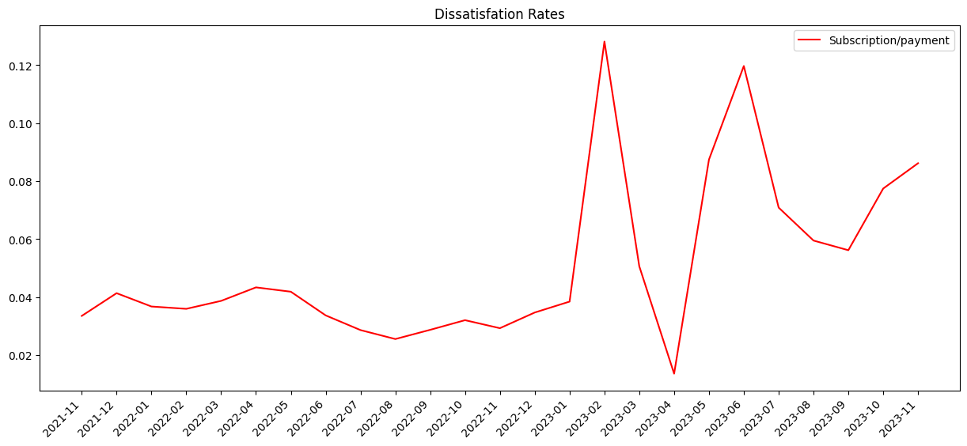

Slide 28
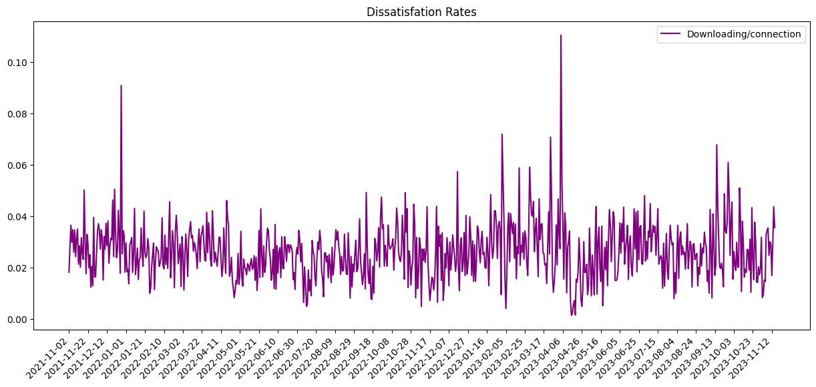
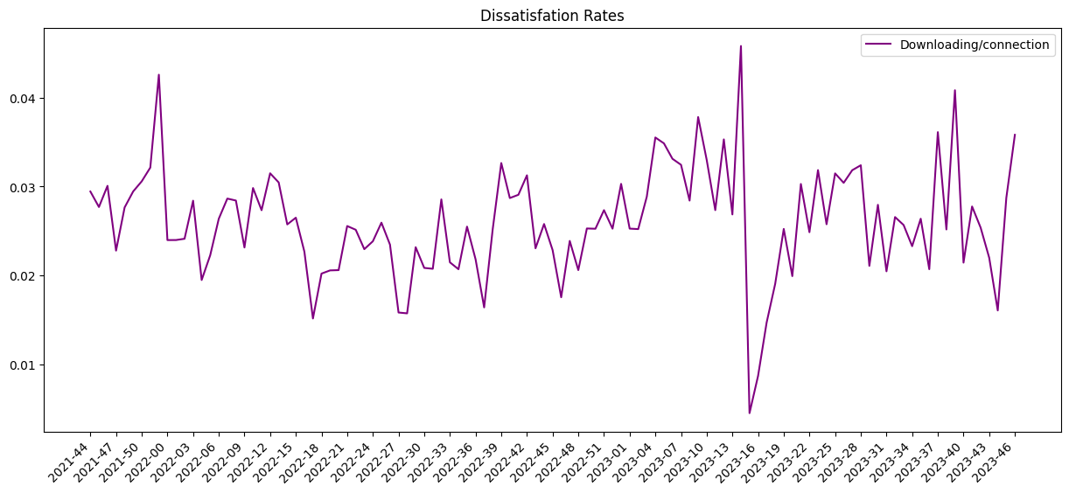
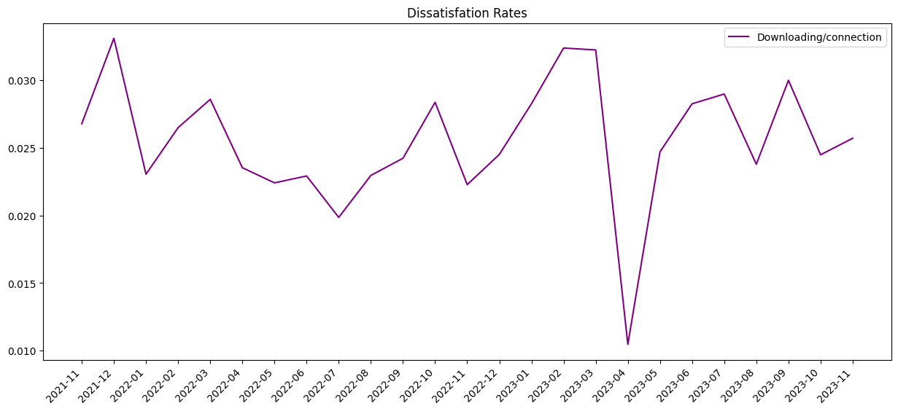

Slide 29
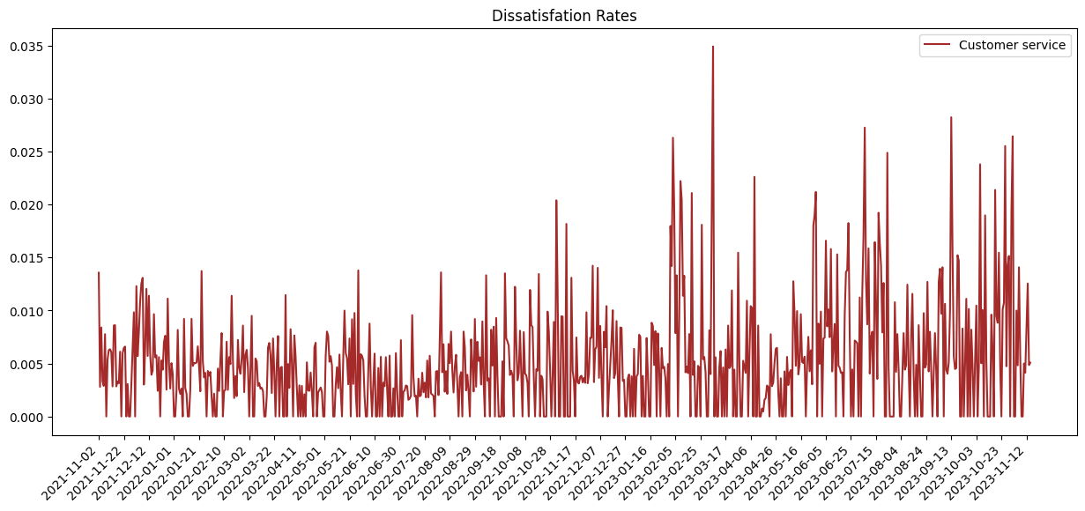
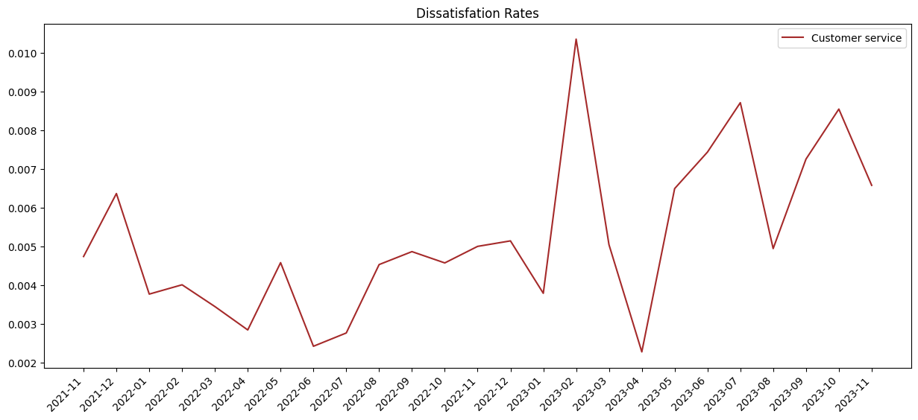
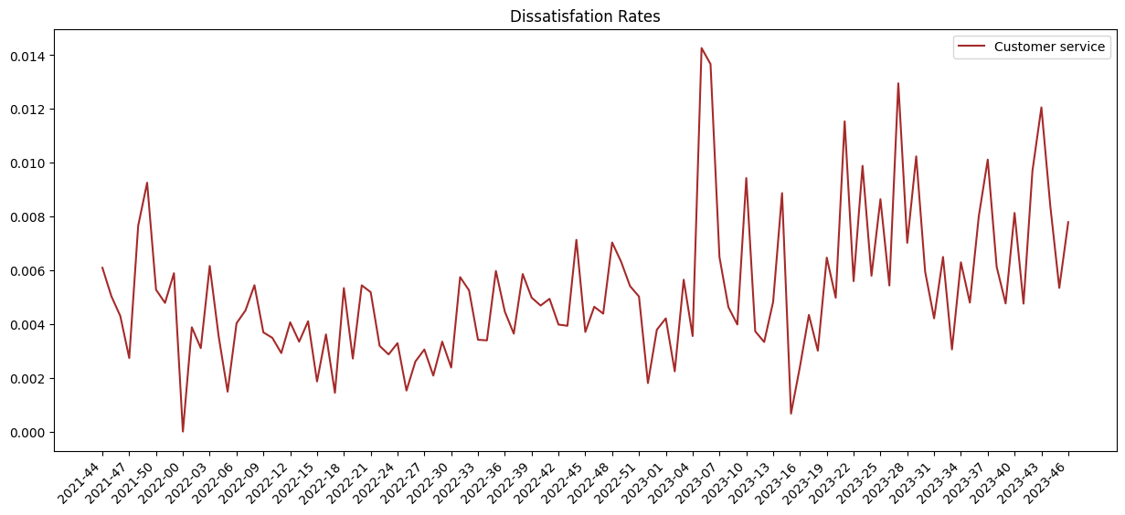

Slide 30
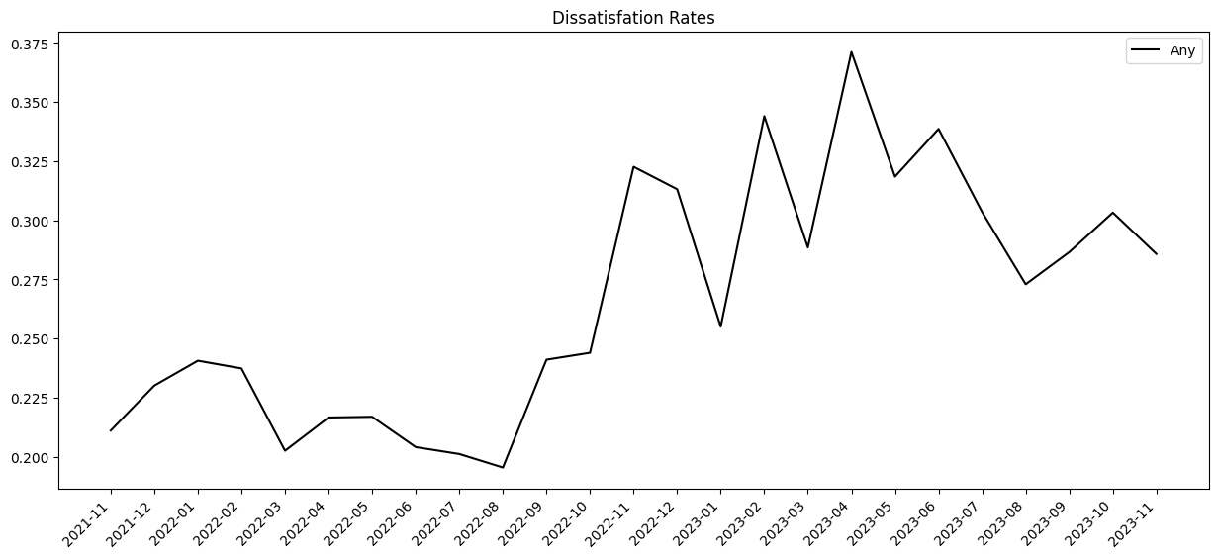
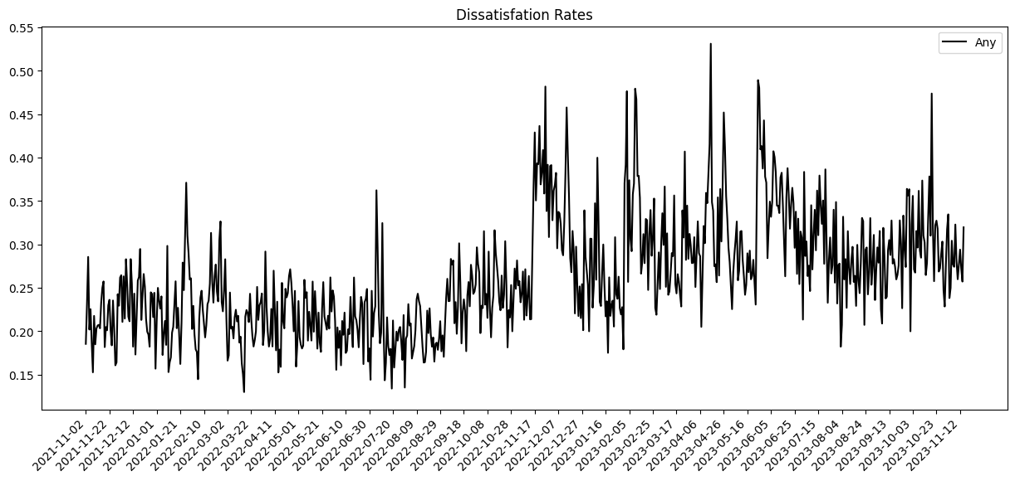
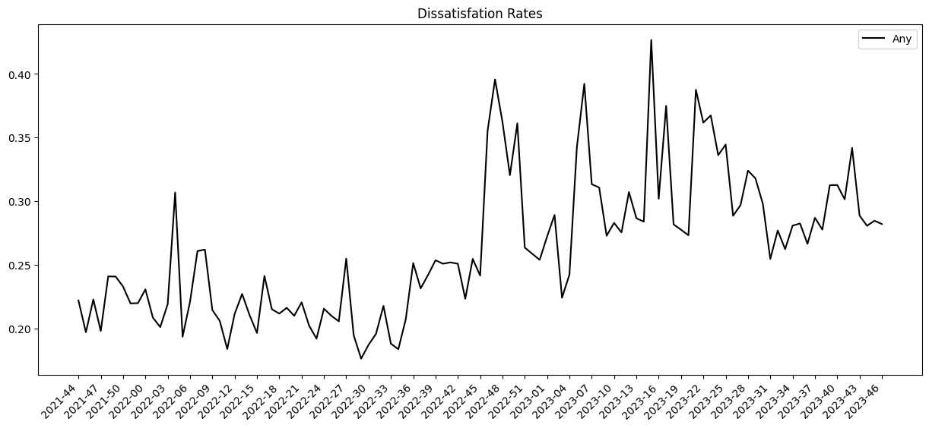

Slide 31
Sentiment Analysis Performance Testing
…

Slide 32
Multi-label Binary Classification
Each data point may contains multiple classes
If target labels is [2,4,3] and predicted is [2,1,3]. Our prediction is neither fully correct nor fully wrong
A prediction containing a subset of the actual classes should be considered better than a prediction that contains none of them
Hamming loss: It does that by exclusive or (XOR) between the actual and predicted labels and then average across the dataset
In above example 2 out of 3 labels have been predicted correctly, Hamming Loss would be 0.33.

Slide 33
GPT-3.5 Turbo 0613
Total item count: 130
Average accurate count: 94.0
Prediction accuracy: 0.723077
Hamming loss: 0.071795

Slide 34
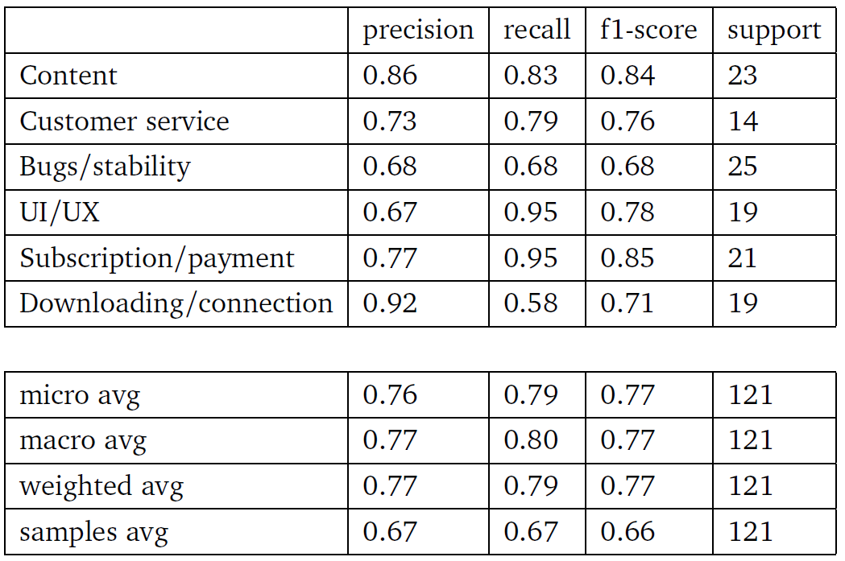
GPT-3.5 Turbo 0613 Classification Report

Slide 35
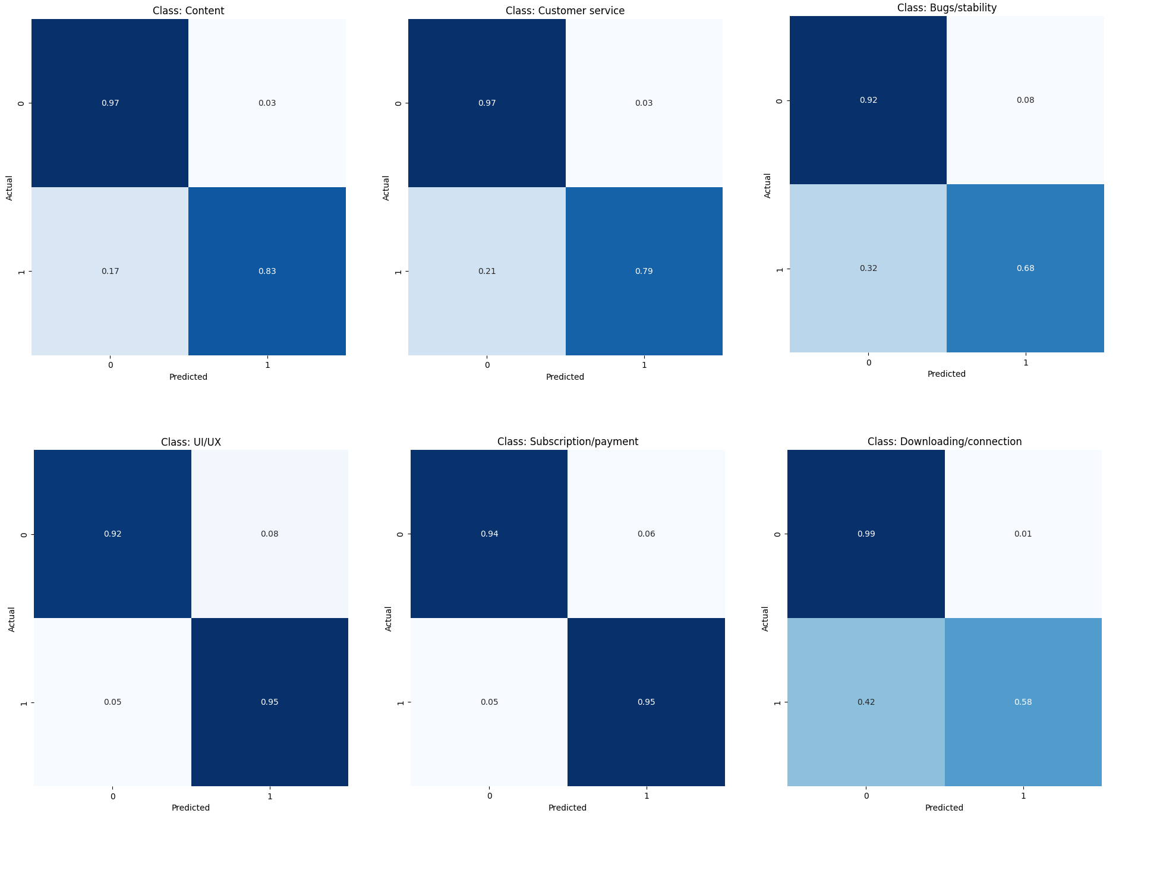
GPT-3.5 Turbo 0613 Confusion Matrix

Slide 36
GPT-3.5 Turbo 1106
Total item count: 130
Average accurate count: 95.0
Prediction accuracy: 0.730769
Hamming loss: 0.060256

Slide 37
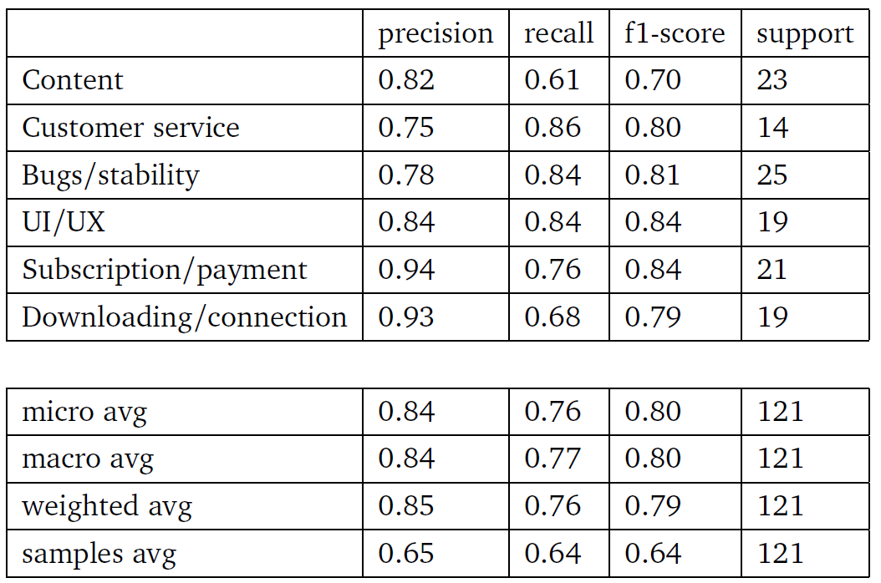
GPT-3.5 Turbo 1106 Classification Report

Slide 38
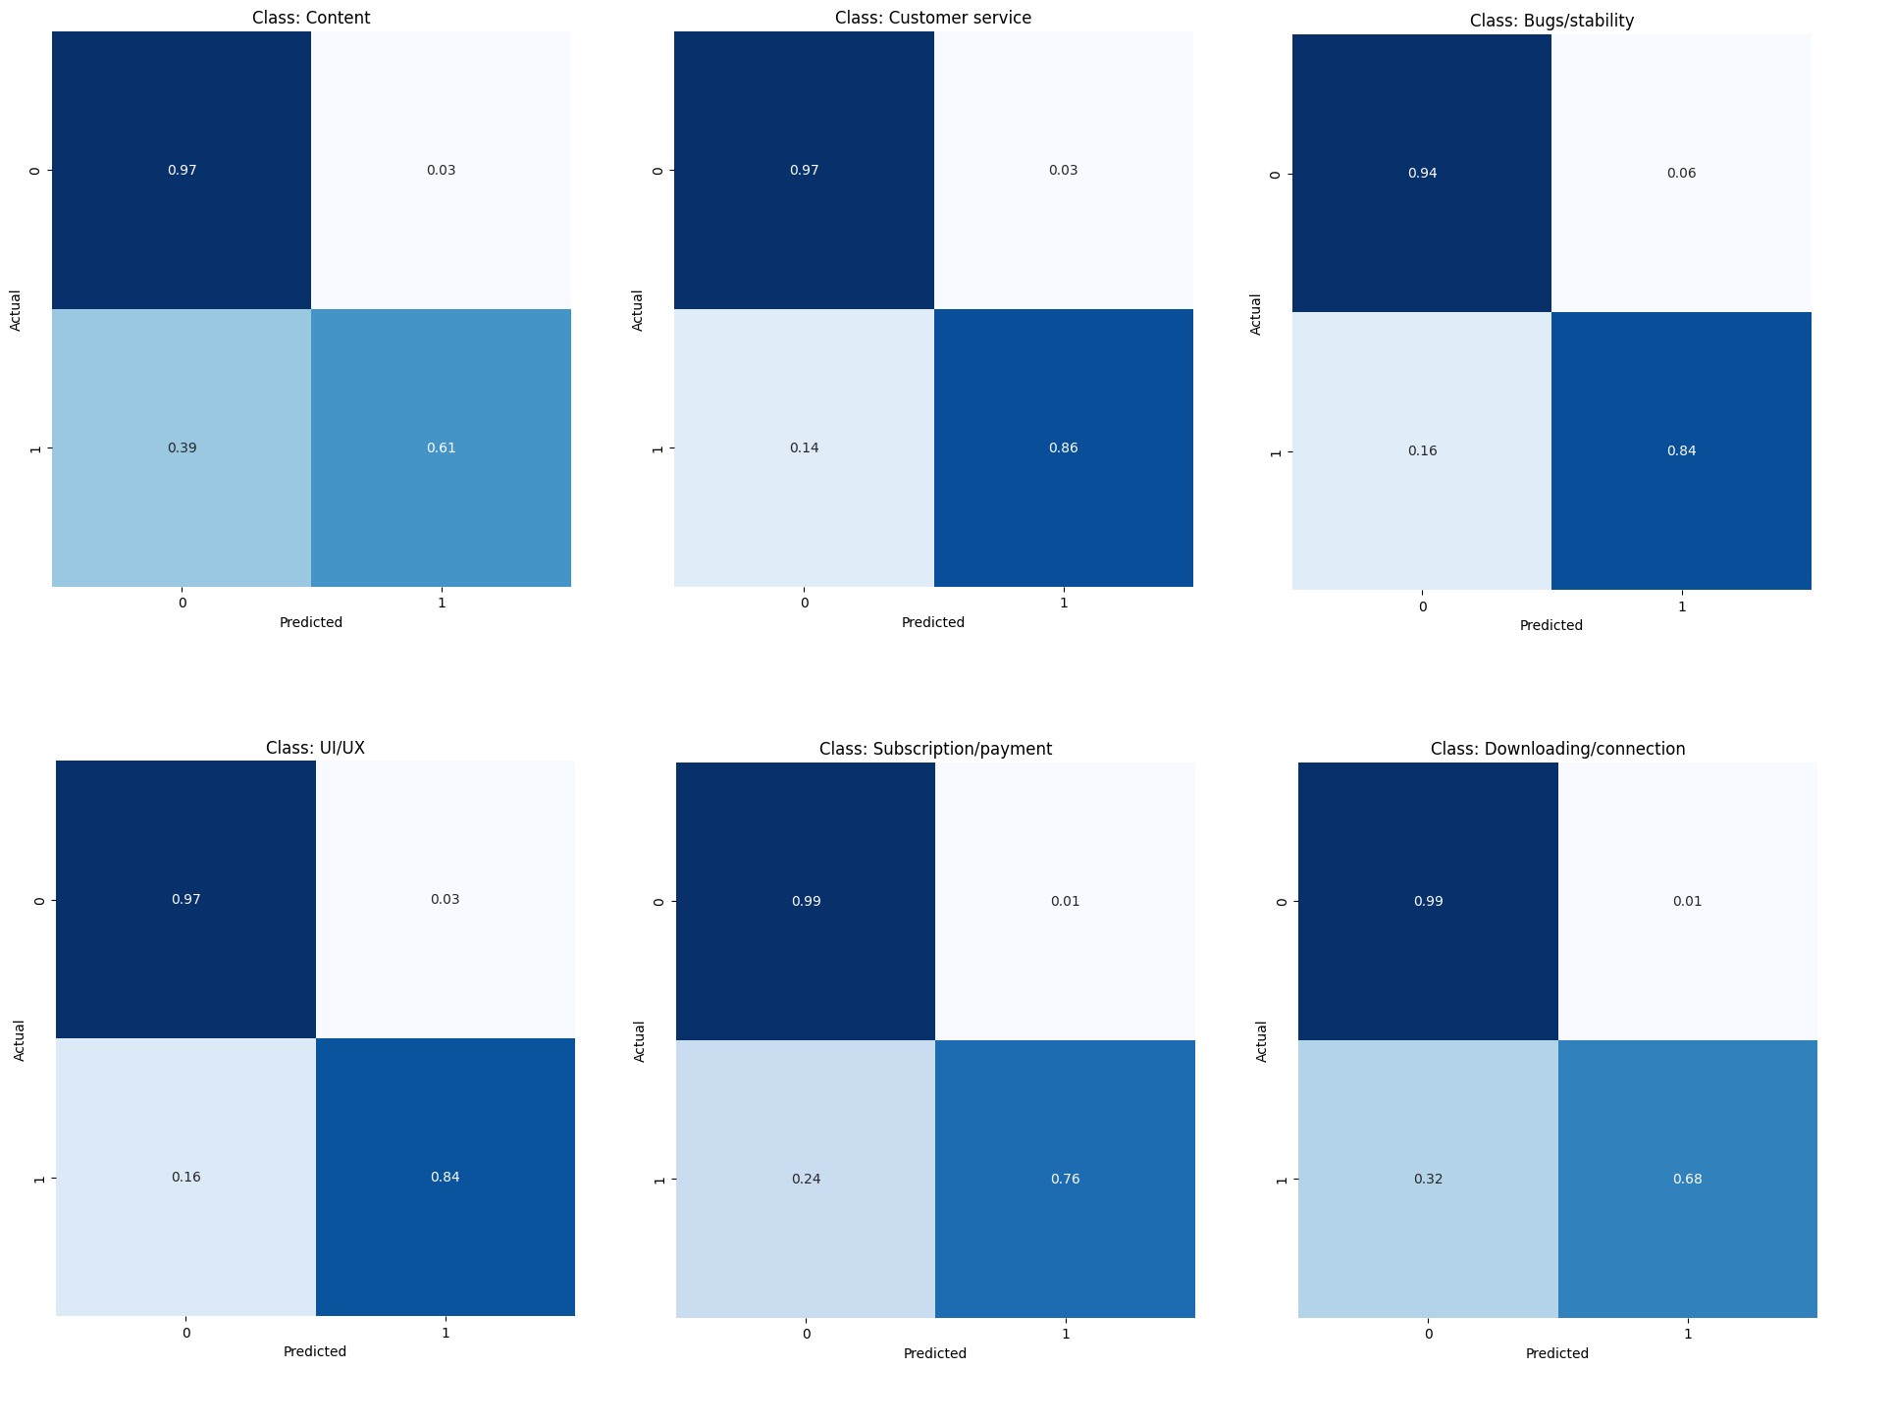
GPT-3.5 Turbo 1106 Confusion Matrix

Slide 39
Finally, Visual Dissatisfaction Testing
…

Slide 40
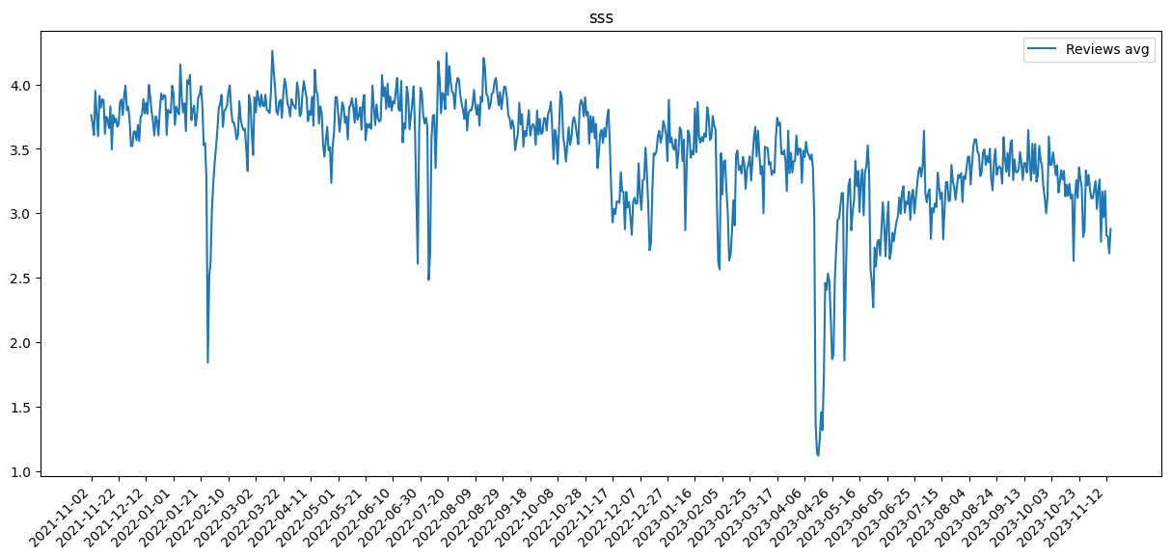

Slide 41
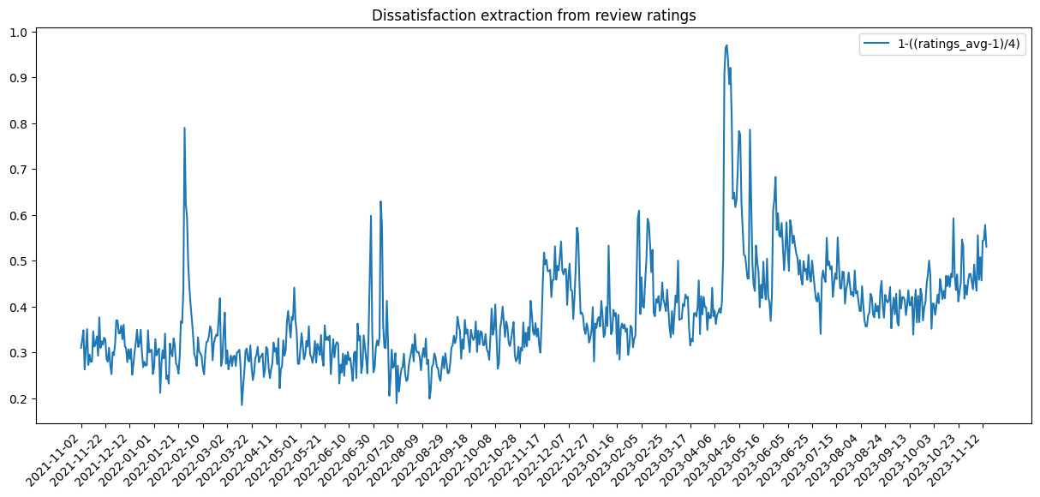

Slide 42
a

Slide 43
Prediction Testing and Results
…

Slide 44
Hyperparameters of LSTM
Loss Function: Mean Squared Error (MSE)
Optimizer: Adam Optimizer
LSTM Layers: 50 unit
Dense Layer: 1 unit, simple for regression problems
Epochs: 100 epochs
Look back: 10 days

Slide 45
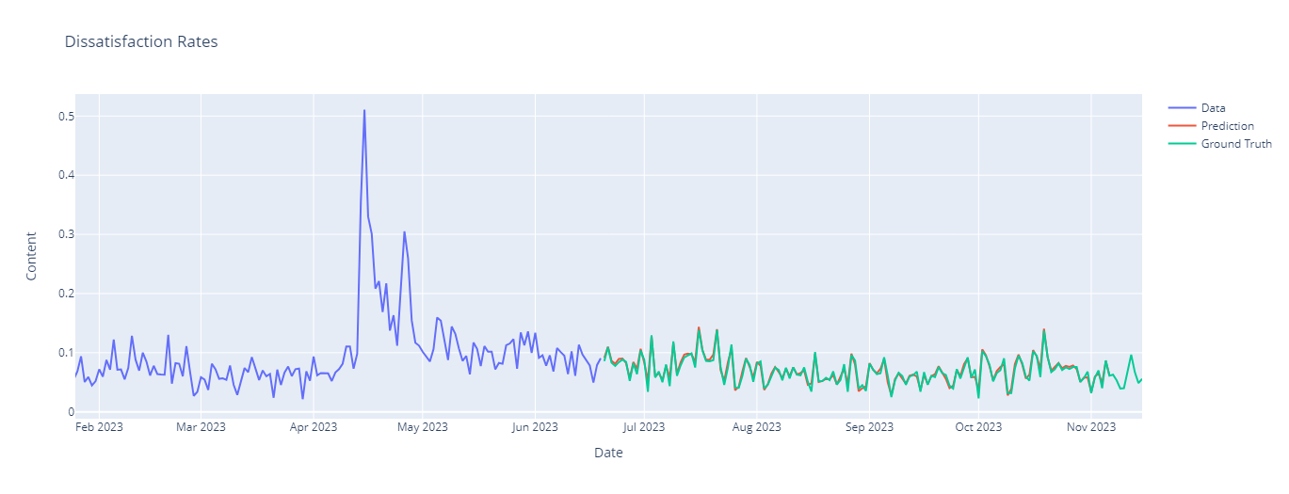
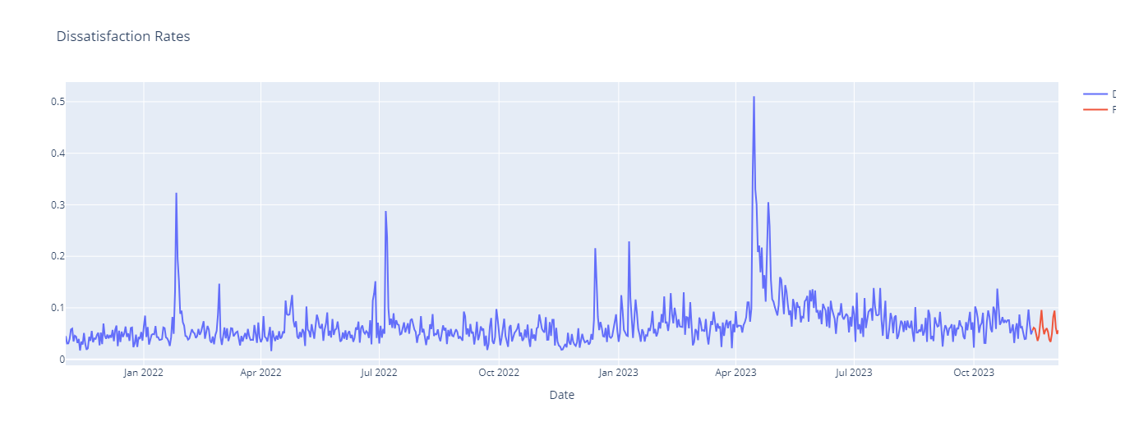

Slide 46
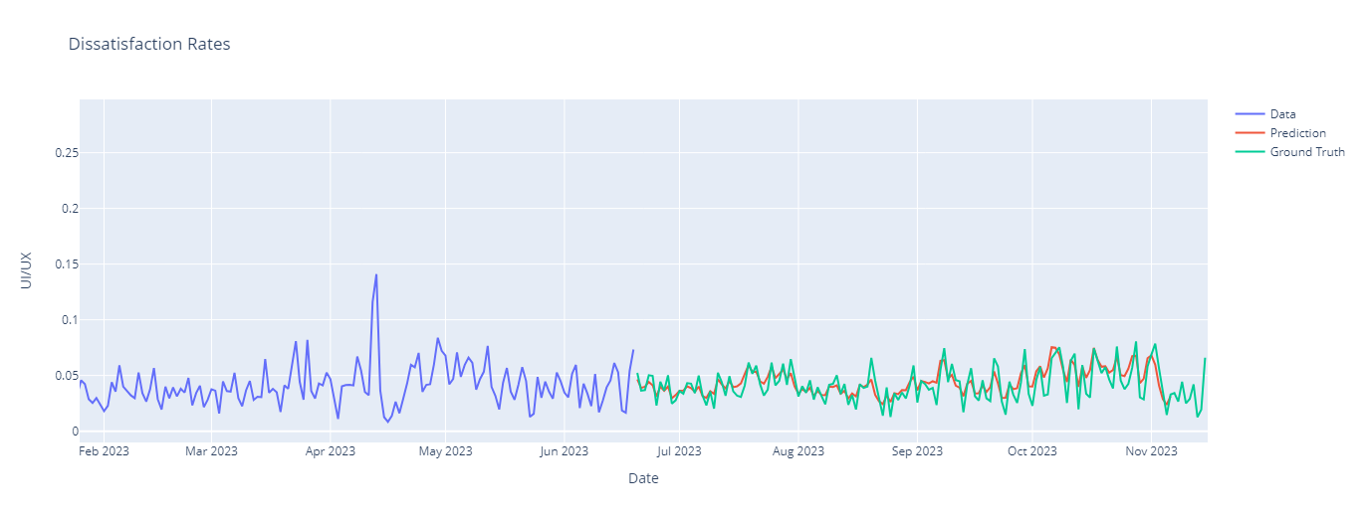
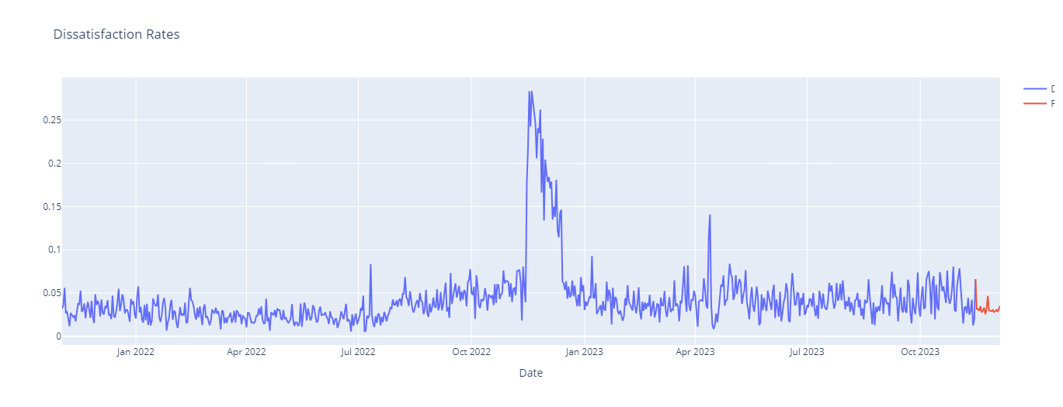

Slide 47
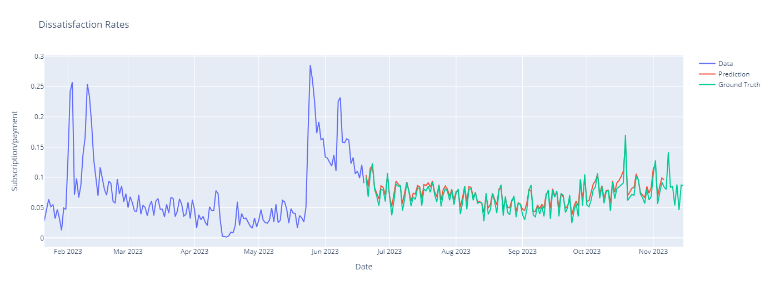
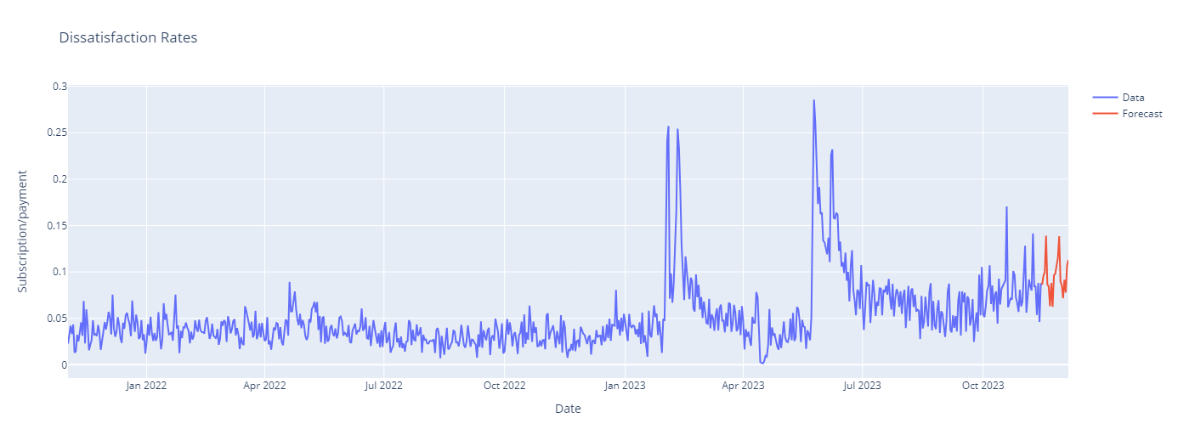

Slide 48
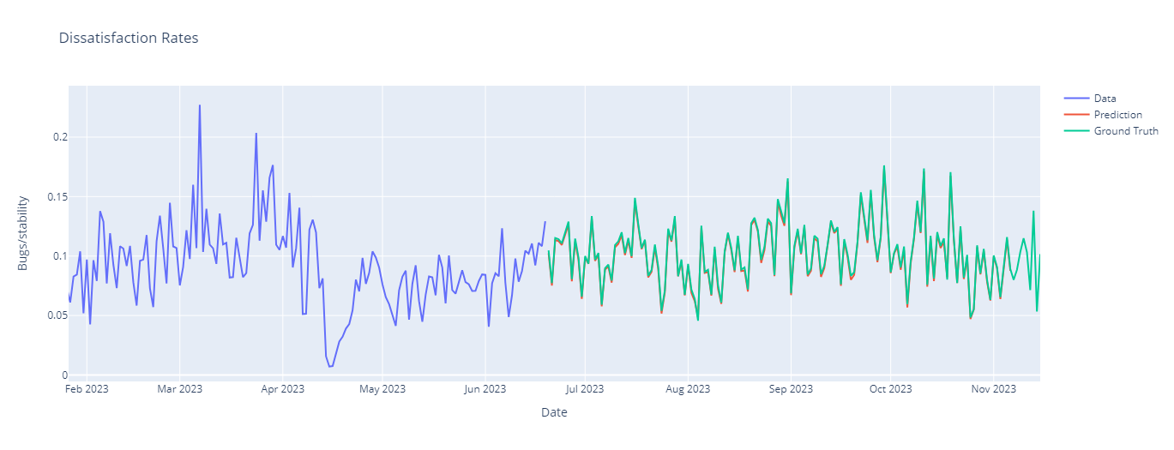
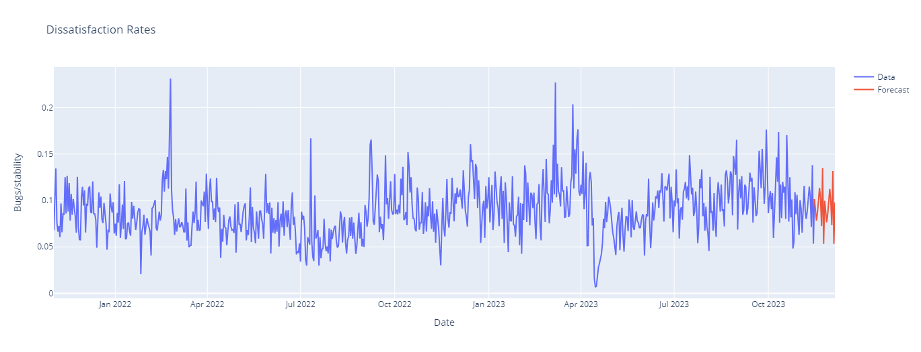

Slide 49
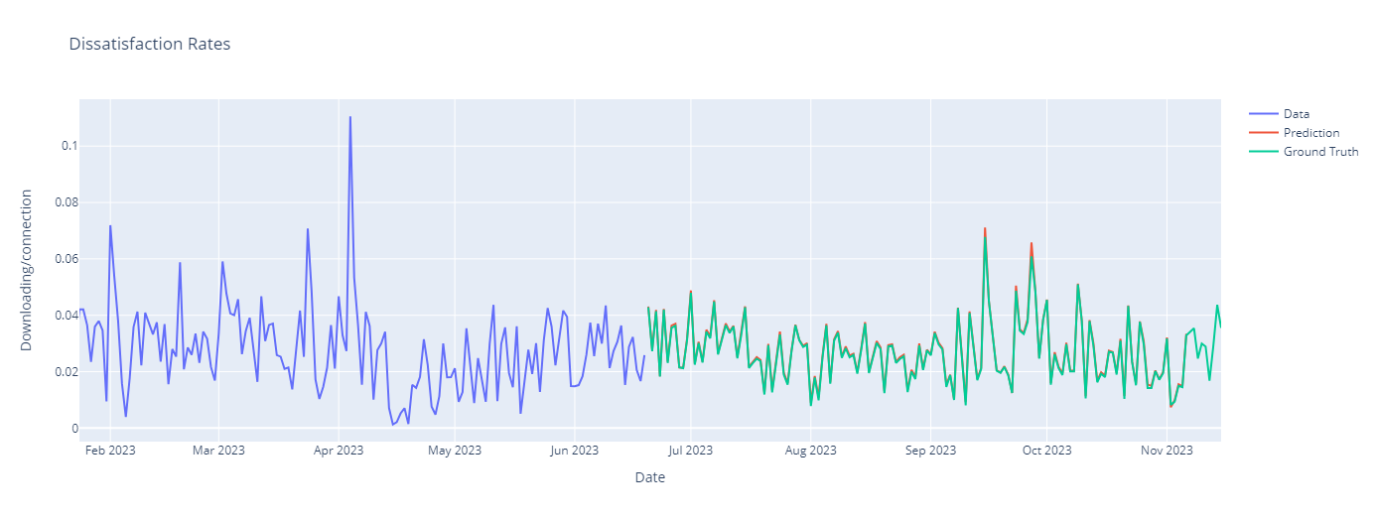
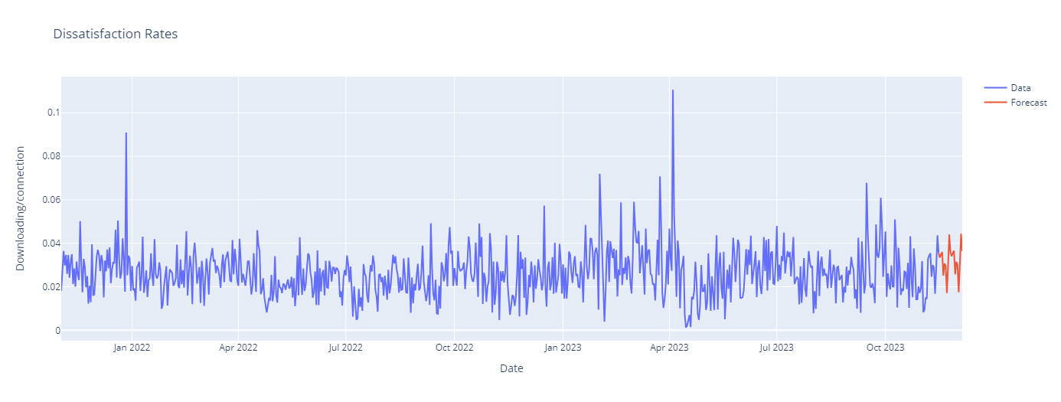

Slide 50
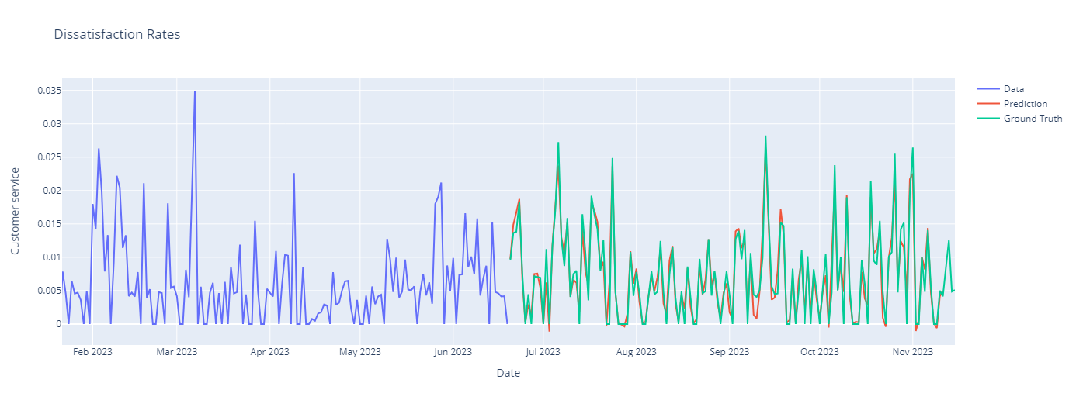
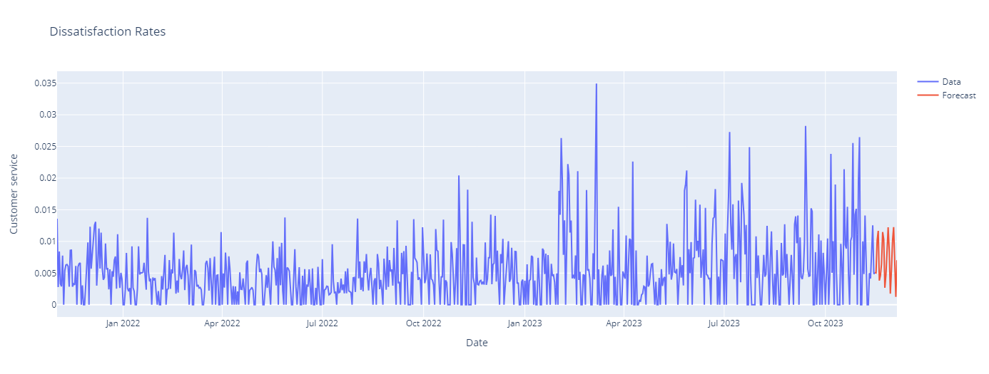

Slide 51
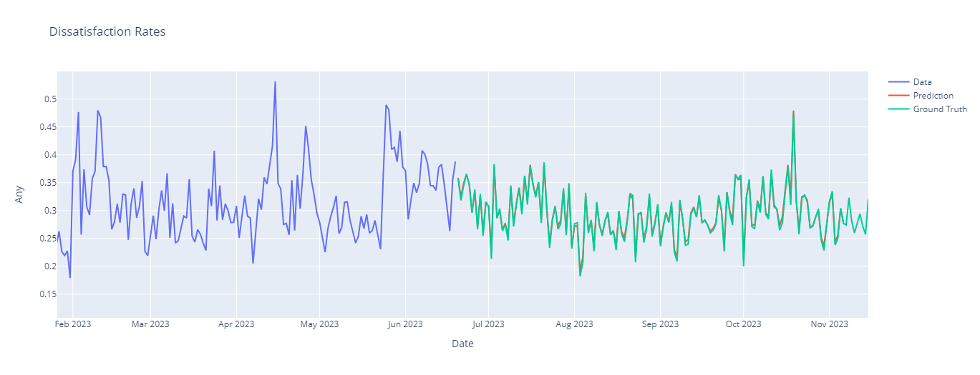
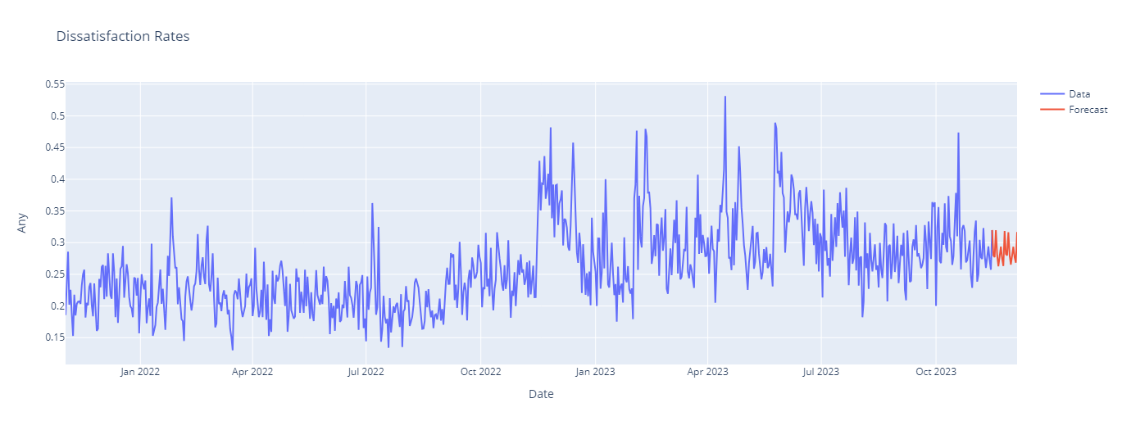

Slide 52
Final thoughts

Slide 53
How would it be better?
Training with more and more data
Seperating categories more precisely
Choosing more meaningful dataset
Using different LLMs
Using different hyperparameters in LSTM

